Slide 1
IS3313 Server Virtualization Fundamentals
Dr John O’Donoghue

Slide 2
Introduction
Virtualization Technique
CPU Virtualization
Emulation techniques
Trap and emulate model
Hardware assistance
Memory Virtualization
Shadow page table
Hardware assistance
IO Virtualization
Overview
Device model
Hardware assistance
Ecosystem
VMware
Xen
KVM
Other Issues
Live migration
Cloud properties

Slide 3
CPU Virtualization
Emulation techniques
Trap and emulate paradigm
Hardware assistance

Slide 4
Emulation Technique
Three emulation implementations :
Interpretation
Emulator interprets only one instruction at a time.
Static Binary Translation
Emulator translates a block of guest binary at a time and further optimizes for repeated instruction executions.
Dynamic Binary Translation
This is a hybrid approach of emulator, which mix two approaches above.
Design challenges and issues:
Register mapping problem
Performance improvement

Slide 5
CPU Virtualization
Emulation techniques
Trap and emulate model
Hardware assistance

Slide 6
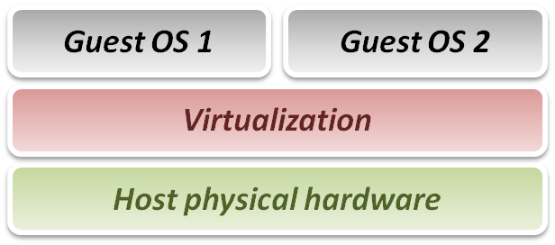
Virtualization Technique
From emulation to virtualization :
While emulation techniques emulate guest on host, whose ISA differ from guest, in virtualization techniques, guest and host have the same ISA.
Some problems in emulation will not exist in virtualization :
No need to translate each binary instruction to host ISA.
No need to worry about unmatched special register mapping.
Some new problems didn’t exist in emulation exist now :
Instruction privileges should be well-controlled.
Goal of virtualization:
Run or simulate all instructions of guest OS.

Slide 7
Virtualization Technique
Virtualization requirements from Popek and Goldberg:
Provide a set of sufficient conditions for a computer architecture to efficiently support system virtualization.
Provide guidelines for the design of virtualized computer architectures.
In Popek and Goldberg terminology, a VMM must present all three properties :
Equivalence (Same as real machine)
Resource control (Totally control)
Efficiency (Native execution)

Slide 8
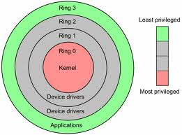
CPU Architecture
Modern CPU status is usually classified as several modes.
In general, we conceptually divide them into two modes :
Kernel mode (Ring 0)
CPU may perform any operation allowed by its architecture, including any instruction execution, IO operation, area of memory access, and so on.
Traditional OS kernel runs in Ring 1 mode.
User mode (Ring 1 ~ 3)
CPU can typically only execute a subset of those available instructions in kernel mode.
Traditional application runs in Ring 3 mode.

Slide 9
CPU Architecture
By the classification of CPU modes, we divide instructions into following types :
Privileged instruction
Those instructions that trap if the machine is in user mode and do not trap if the machine is in kernel mode.
Sensitive instructions
Those instructions that interact with hardware, which include control-sensitive and behavior-sensitive instructions.
Innocuous instruction
All other instructions.
Critical instruction
Those sensitive but not privileged instructions.

Slide 10
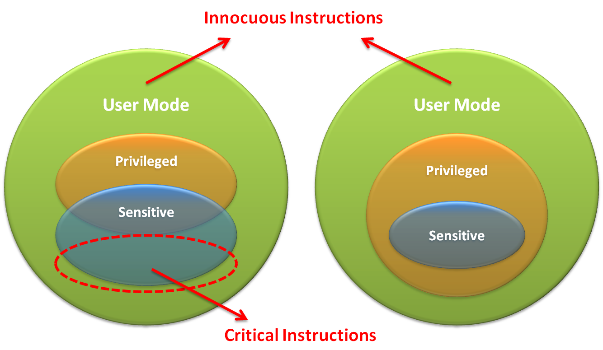
CPU Architecture

Slide 11
CPU Architecture
What is trap ?
When CPU is running in user mode, some internal or external events, which need to be handled in kernel mode, take place.
Then CPU will jump to hardware exception handler vector, and execute system operations in kernel mode.
Trap types :
System Call
Invoked by application in user mode.
For example, application ask OS for system IO.
Hardware Interrupts
Invoked by some hardware events in any mode.
For example, hardware clock timer trigger event.
Exception
Invoked when unexpected error or system malfunction occur.
For example, execute privilege instructions in user mode.

Slide 12
Trap and Emulate Model
If we want CPU virtualization to be efficient, how should we implement the VMM ?
We should make guest binaries run on CPU as fast as possible.
Theoretically speaking, if we can run all guest binaries natively, there will NO overhead at all.
But we cannot let guest OS handle everything, VMM should be able to control all hardware resources.
Solution :
Ring Compression
Shift traditional OS from kernel mode(Ring 0) to user mode(Ring 1), and run VMM in kernel mode.
Then VMM will be able to intercept all trapping event.

Slide 13
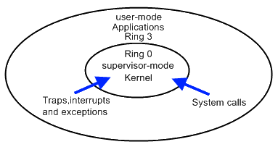
Trap and Emulate Model
VMM virtualization paradigm (trap and emulate) :
Let normal instructions of guest OS run directly on processor in user mode.
When executing privileged instructions, hardware will make processor trap into the VMM.
The VMM emulates the effect of the privileged instructions for the guest OS and return to guest.

Slide 14
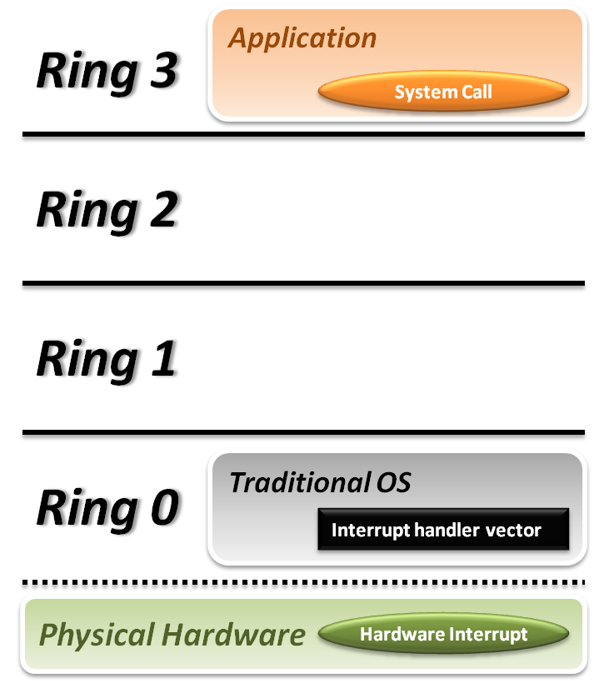


Trap and Emulate Model
Traditional OS:
When application invoke a system call :
CPU will trap to interrupt handler vector in OS.
CPU will switch to kernel mode (Ring 0) and execute OS instructions.
When hardware event:
Hardware will interrupt CPU execution, and jump to interrupt handler in OS.

Slide 15
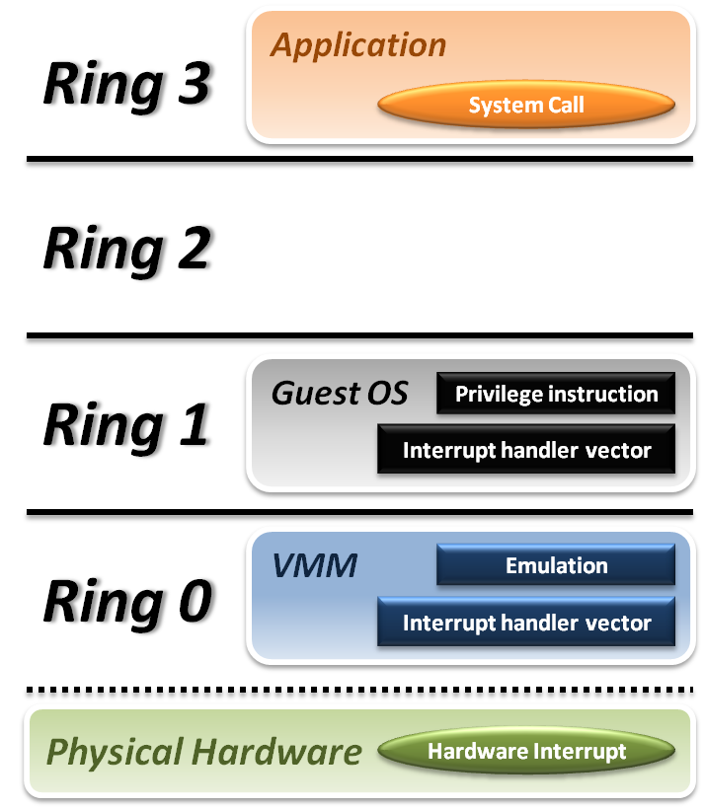






Trap and Emulate Model
VMM and Guest OS:
System Call
CPU will trap to interrupt handler vector of VMM.
VMM jump back into guest OS.
Hardware Interrupt
Hardware make CPU trap to interrupt handler of VMM.
VMM jump to corresponding interrupt handler of guest OS.
Privilege Instruction
Running privilege instructions in guest OS will be trapped to VMM for instruction emulation.
After emulation, VMM jump back to guest OS.

Slide 16
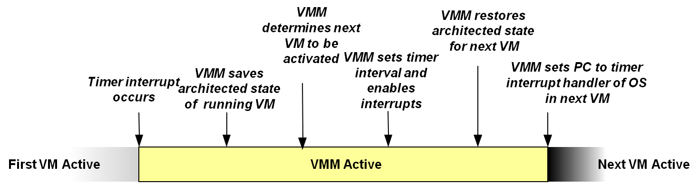
Context Switch
Steps of VMM switch different virtual machines :
Timer Interrupt in running VM.
Context switch to VMM.
VMM saves state of running VM.
VMM determines next VM to execute.
VMM sets timer interrupt.
VMM restores state of next VM.
VMM sets PC to timer interrupt handler of next VM.
Next VM active.

Slide 17
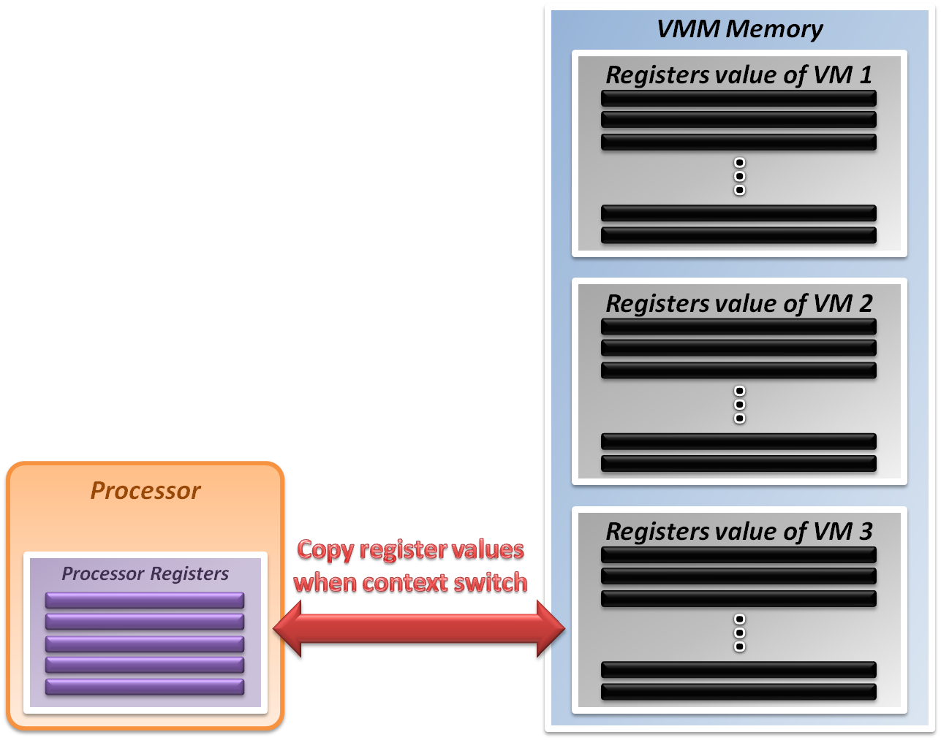
System State Management
Virtualizing system state:
VMM will hold the system states of all virtual machines in memory.
When VMM context switch from one virtual machine to another
Write the register values back to memory
Copy the register values of next guest OS to CPU registers.

Slide 18
Virtualization Theorem
Subset theorem:
For any conventional third-generation computer, a VMM may be constructed if the set of sensitive instructions for that computer is a subset of the set of privileged instructions.
Recursive Emulation:
A conventional third-generation computer is recursively virtualizable if
It is virtualizable
VMM without any timing dependencies can be constructed for it.
Under this theorem, x86 architecture cannot be virtualized directly. Other techniques are needed.

Slide 19
Virtualization Techniques
How to virtualize unvirtualizable hardware:
Para-virtualization
Modify guest OS to skip the critical instructions.
Implement some hyper-calls to trap guest OS to VMM.
Binary translation
Use emulation technique to make hardware virtualizable.
Skip the critical instructions by means of these translations.
Hardware assistance
Modify or enhance ISA of hardware to provide virtualizable architecture.
Reduce the complexity of VMM implementation.

Slide 20
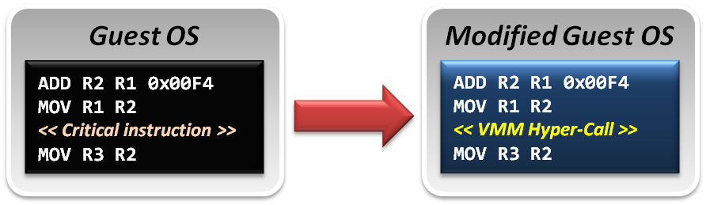
Para-Virtualization
Para-Virtualization implementation :
In para-virtualization technique, guest OS should be modified to prevent invoking critical instructions.
Instead of knowing nothing about hypervisor, guest OS will be aware of the existence of VMM, and collaborate with VMM smoothly.
VMM will provide the hyper-call interfaces, which will be the communication channel between guest and host.

Slide 21
Binary Translation
In emulation techniques :
Binary translation module is used to optimize binary code blocks, and translate binaries from guest ISA to host ISA.
In virtualization techniques :
Binary translation module is used to skip or modify the guest OS binary code blocks which include critical instructions.
Translate those critical instructions into some privilege instructions which will trap to VMM for further emulation.

Slide 22
Binary Translation
Static approach vs. Dynamic approach :
Static binary translation
The entire executable file is translated into an executable of the target architecture.
This is very difficult to do correctly, since not all the code can be discovered by the translator.
Dynamic binary translation
Looks at a short sequence of code, typically on the order of a single basic block, translates it and caches the resulting sequence.
Code is only translated as it is discovered and when possible, branch instructions are made to point to already translated and saved code.

Slide 23
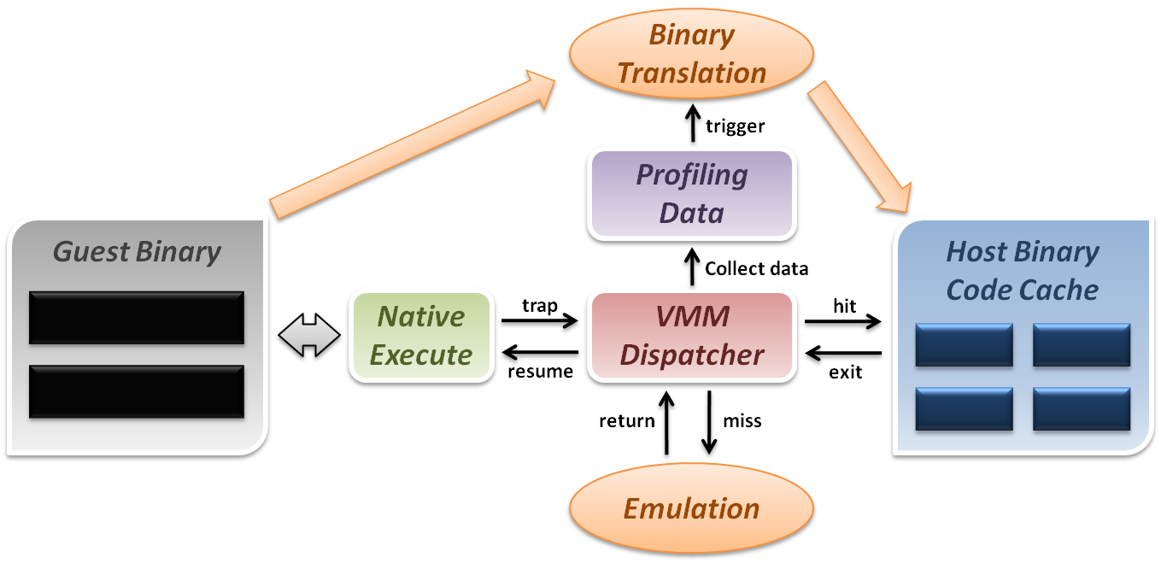
Binary Translation
Dynamic binary translation and optimization
VMM can dynamically translate binary code and collect profiling data for further optimization.

Slide 24
Some Difficulties
Difficulties of binary translation:
Self-modifying code
If guest OS will modify its own binary code in runtime, binary translation need to flush the responding code cache and retranslate the code block.
Self-reference code
If guest code need to reference(read) its own binary code in runtime, VMM need to make it referring back to original guest binaries location.
Real-time system
For some timing critical guest OS, emulation environment will lose precise timing, and this problem cannot be perfectly solved yet.
Difficulty of para-virtualization:
Guest OS modification
User should at least have the source code of guest OS and modify its kernel; otherwise, para-virtualization cannot be used.

Slide 25
CPU Virtualization
Emulation techniques
Trap and emulate model
Hardware assistance

Slide 26
Hardware Solution
Why are there so many problems and difficulties ?
Critical instructions do not trap in user mode.
Even if we make those critical instructions trap, their semantics may also be changed; which is not acceptable.
In short, legacy processors did not design for virtualization from the off.
If processor can be aware of the different behaviors between guest and host, the VMM design will be more efficient and simple.

Slide 27
Hardware Solution
Let’s go back to the trap model :
Some trap types do not need the VMM involvement.
For example, all system calls invoked by application in guest OS should be caught by guest OS only. There is no need to trap to VMM and then forward it back to guest OS, which will introduce context switch overhead.
Some critical instructions should not be executed by guest OS.
Although we make those critical instructions trap to VMM, the VMM cannot identify whether this trapping action is caused by the emulation purpose or the real OS execution exception.
Solution :
We need to redefine the semantics of some instructions.
We need to introduce new CPU control paradigm.

Slide 28
Intel VT-x
In order to straighten those problems out, Intel introduces an additional operational mode for the x86 architecture.
VMX Root Operation (Root Mode)
All instruction behaviors in this mode are no different to traditional ones.
All legacy software can run in this mode correctly.
VMM should run in this mode and control all system resources.
VMX Non-Root Operation (Non-Root Mode)
All sensitive instruction behaviors in this mode are redefined.
The sensitive instructions will trap to Root Mode.
Guest OS should run in this mode and be fully virtualized through typical “trap and emulation model”.

Slide 29
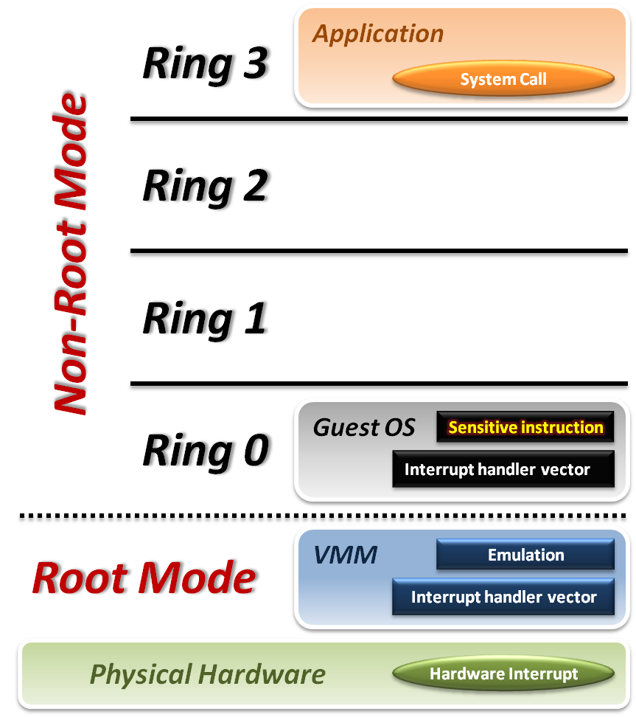





Intel VT-x
VMM with VT-x:
System Call
CPU will directly trap to interrupt handler vector of guest OS.
Hardware Interrupt
Still, hardware events need to be handled by VMM first.
Sensitive Instruction
Instead of trap all privilege instructions, running guest OS in Non-root mode will trap sensitive instruction only.

Slide 30
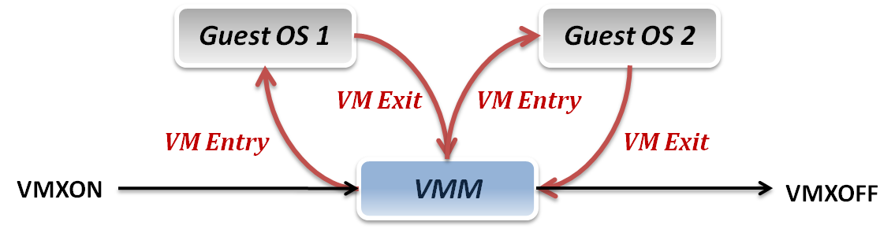
Context Switch
VMM switch different virtual machines with Intel VT-x:
VMXON/VMXOFF
These two instructions are used to turn on/off CPU Root Mode.
VM Entry
This is usually caused by the execution of VMLAUNCH/VMRESUME instructions, which will switch CPU mode from Root Mode to Non-Root Mode.
VM Exit
This may be caused by many reasons, such as hardware interrupts or sensitive instruction executions.
Switch CPU mode from Non-Root Mode to Root Mode.

Slide 31
System State Management
Intel introduces a more efficient hardware approach for register switching, VMCS (Virtual Machine Control Structure) :
State Area
Store host OS system state when VM-Entry.
Store guest OS system state when VM-Exit.
Control Area
Control instruction behaviors in Non-Root Mode.
Control VM-Entry and VM-Exit process.
Exit Information
Provide the VM-Exit reason and some hardware information.
Whenever VM Entry or VM Exit occur, CPU will automatically read or write corresponding information into VMCS.

Slide 32
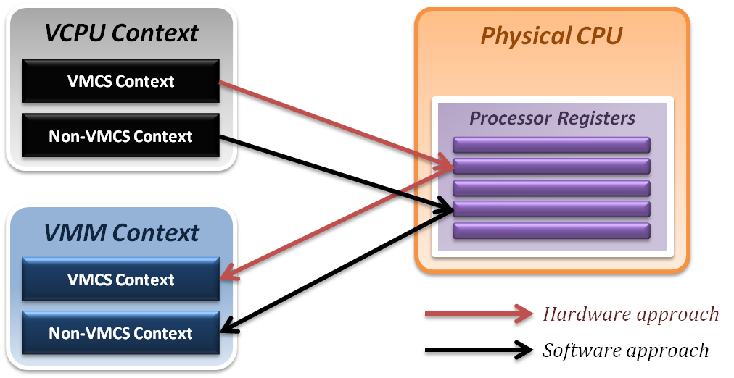
System State Management
Binding virtual machine to virtual CPU
VCPU (Virtual CPU) contains two parts
VMCS maintains virtual system states, which is approached by hardware.
Non-VMCS maintains other non-essential system information, which is approach by software.
VMM needs to handle Non-VMCS part.

Slide 33
CPU Virtualization Summary
Emulation technique
Interpretation and binary translation approaches
System state mapping and performance issue
Translation chaining, Dynamic binary optimization
Virtualization technique
Modern CPU architecture
Trap and emulation model
Critical instruction issue
Para-virtualization, Dynamic binary translation
Hardware assistance
Intel VT-x approach
Root Mode & Non-Root Mode

Slide 34
Memory Virtualization
Shadow page table
Hardware assistance

Slide 35
Memory Virtualization
Memory management in OS:
Traditionally, OS fully controls all physical memory space and provide a continuous addressing space to each process.
In server virtualization, VMM should make all virtual machines share the physical memory space without knowing the fact.
Goals of memory virtualization:
Address Translation
Control table-walking hardware that accesses translation tables in main memory.
Memory Protection
Define access permission which uses the Access Control Hardware.
Access Attribute
Define attribute and type of memory region to direct how memory operation to be handled.
Note: Virtual memory address translation uses page tables. These are simple arrays in memory indexed by page number. A page table base register (PTBR) holds the base address for the page table of the current process. Each page table entry contains information about a single page. The most important part of this information is a frame number — where the page is located in physical memory. Address translation combines the frame number with the offset part of a logical address to form a physical address.

Slide 36
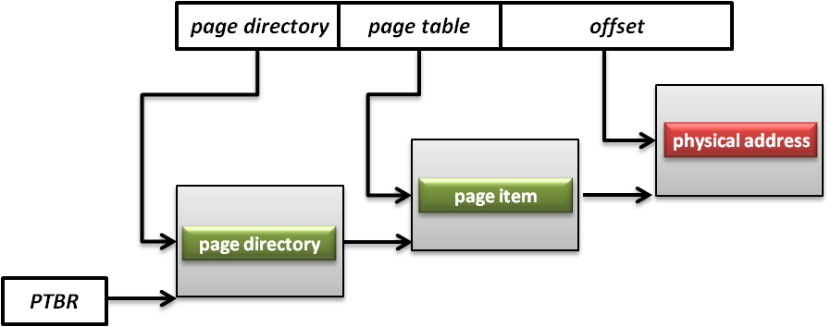
Memory Architecture
Memory Management Unit (MMU)
What is MMU ?
A computer hardware component responsible for handling accesses to memory requested by the CPU.
Its functions include translation of virtual addresses to physical addresses, memory protection, cache control, bus arbitration and etc.
What is PTBR ?
Page Table Base Register (PTBR) is a register point to the base of page table for MMU.

Slide 37
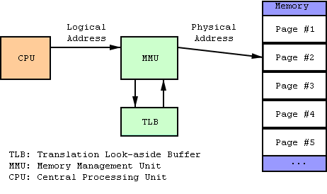
Memory Architecture
Translation Lookaside Buffer (TLB)
What is TLB ?
A CPU cache that memory management hardware uses to improve virtual address translation speed.

Slide 38
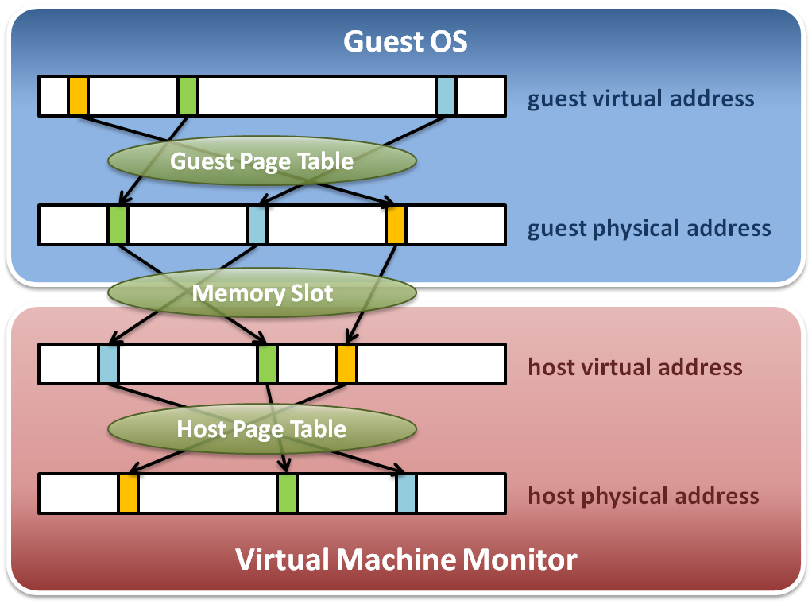
Memory Virtualization
Memory virtualization architecture

Slide 39
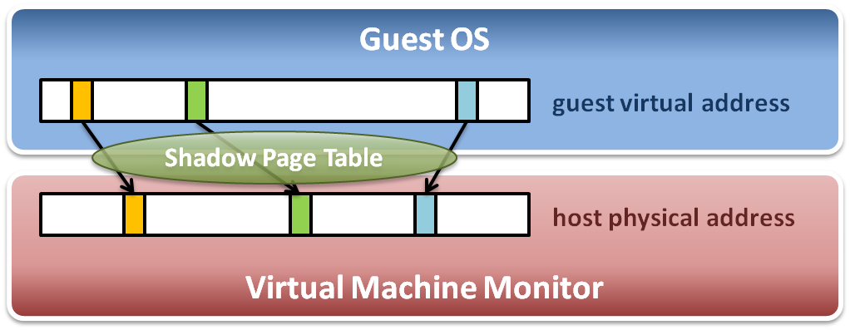
Memory Virtualization
The performance drop of memory access is usually unbearable. VMM needs further optimization.
VMM maintains shadow page tables :
Direct virtual-to-physical address mapping
Use hardware TLB for address translation

Slide 40
Shadow Page Table
Map guest virtual address to host physical address
Shadow page table
Guest OS will maintain its own virtual memory page table in the guest physical memory frames.
For each guest physical memory frame, VMM should map it to host physical memory frame.
Shadow page table maintains the mapping from guest virtual address to host physical address.
Page table protection
VMM will apply write protection to all the physical frames of guest page tables, which lead the guest page table write exception and trap to VMM.

Slide 41
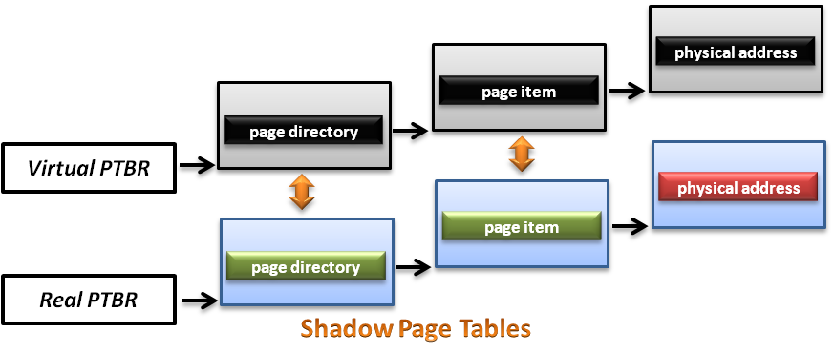
Shadow Page Table
How does this technique work?
VMM should make MMU virtualized
VMM manages the real PTBR and a virtual PTBR for each VM
When guest OS is activated, the real PTBR points to a shadow page table
When guest OS attempts to modify the PTBR, it will be intercepted by VMM for further emulation

Slide 42
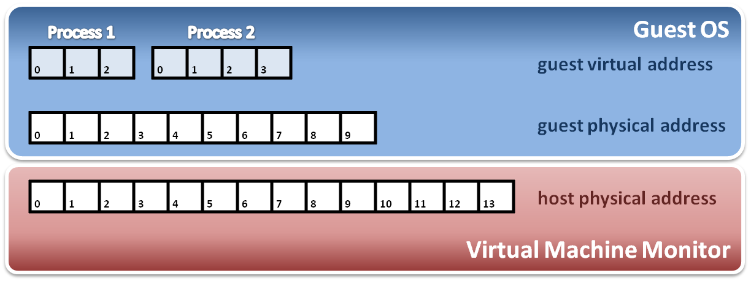
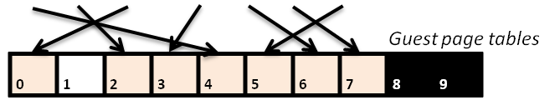
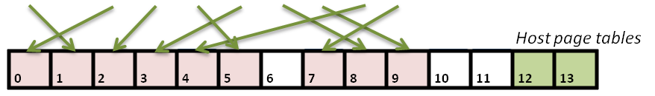
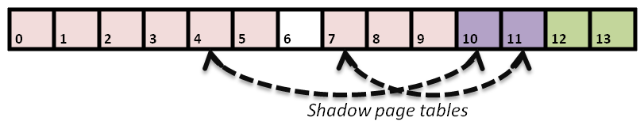
Shadow Page Table
Construct shadow page table
Guest OS will maintain its own page table for each process.
VMM maps each guest physical page to host physical page.
Create shadow page tables for each guest page table.
VMM should protect host frame which contains guest page table.
Write protection

Slide 43
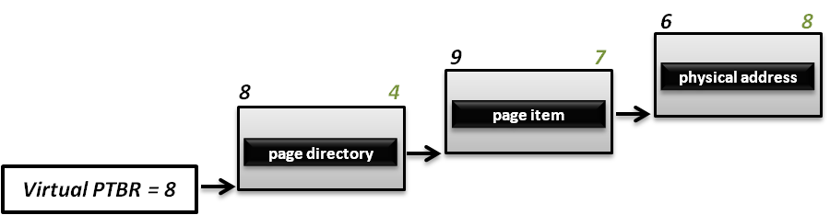
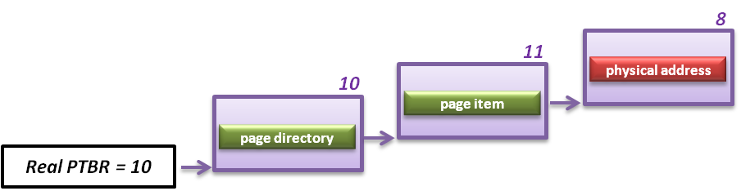
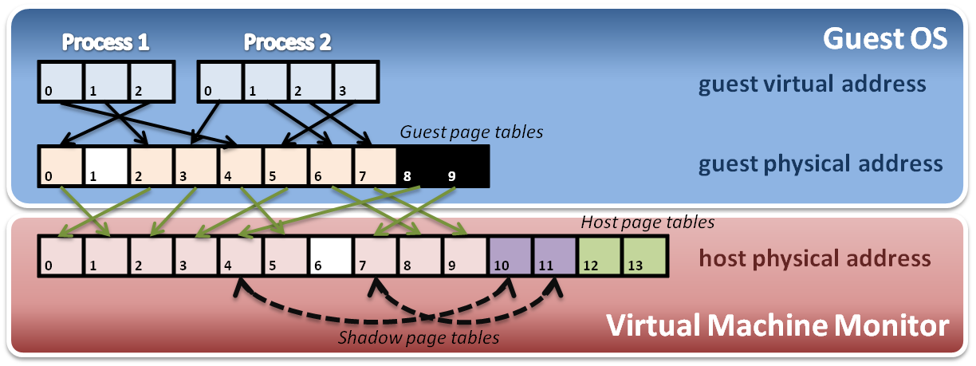
Shadow Page Table
Implement with PTBR

Slide 44
Shadow Page Table
Shadow page table operations :
Context switch
New process
Access
Process
Page Table
Process
Page Table
Process
Page Table
Virtual PTPR
Guest OS
Real PTPR
VMM
Page fault !
Shadow
Page Table
Shadow
Page Table
Shadow
Page Table
Load !
Corresponding mapping table
Switch the pointer to new location
Create new shadow page table mapping to new process

Slide 45
Other Issues
Page fault and page protection issue
When a physical page fault occurs, VMM need to decide whether this exception should be injected to guest OS or not.
If the page entry in the page table of guest OS is still valid, VMM should prepare the corresponding page and not inject any exception to guest OS.
If the page entry in the page table of guest Os is invalid either, then VMM should directly inject the virtual page fault to guest OS.
When guest OS want to modify its page tables, VMM need to intercept this operation.
When guest OS reload PTBR, CPU will trap to VMM due to the Ring Compression nature.
VMM will walk the page table of guest OS and modify the related shadow page table to make MMU get host physical address.

Slide 46
Memory Virtualization
Shadow page table
Hardware assistance

Slide 47
Hardware Solution
Difficulties of shadow page table technique:
Shadow page table implementation is extremely complex.
Page fault mechanism and synchronization issues are critical.
Host memory space overhead is considerable.
But why we need this technique to virtualize MMU ?
MMU do not first implemented for virtualization.
MMU is knowing nothing about two level page address translation.
Now, let us consider hardware solution.

Slide 48
Extended Page Table
Concept of Extended Page Table (EPT) :
Instead of walking along with only one page table hierarchy, EPT technique implement one more page table hierarchy.
One page table is maintained by guest OS, which is used to generate guest physical address.
The other page table is maintained by VMM, which is used to map guest physical address to host physical address.
For each memory access operation, EPT MMU will directly get guest physical address from guest page table, and then get host physical address by the VMM mapping table automatically.

Slide 49
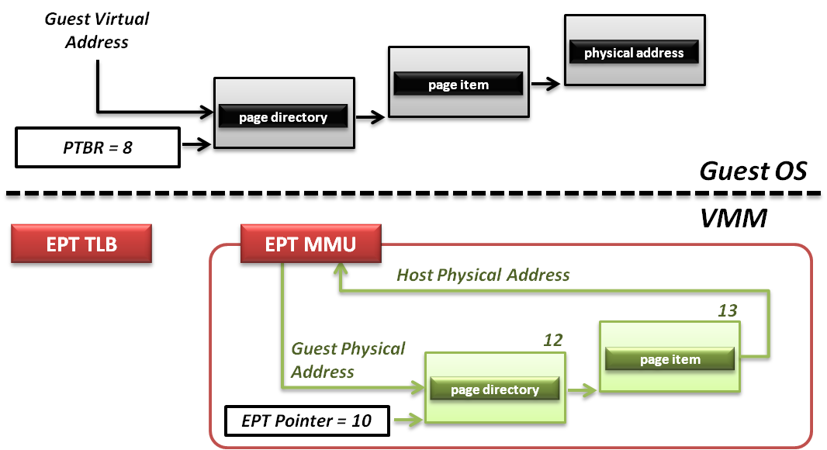
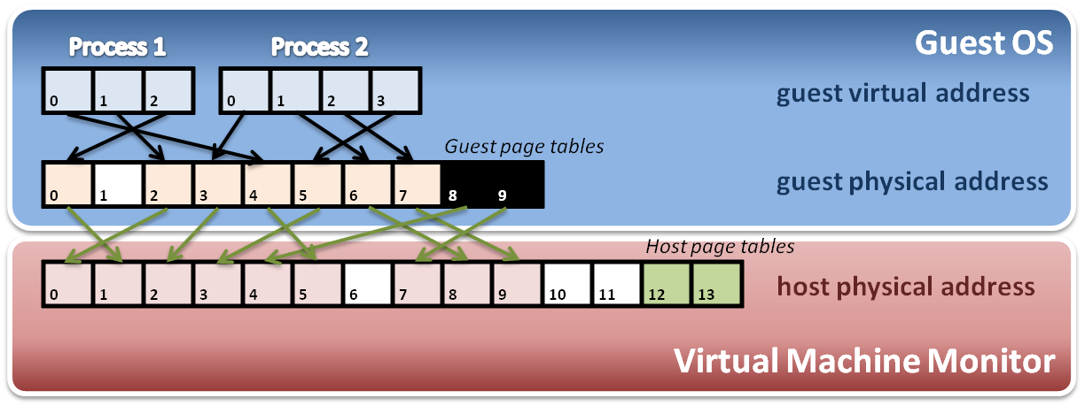
Extended Page Table
Memory operation :
6
8
9
7
8
4
Data

Slide 50
Memory Virtualization Summary
Software implementation
Memory architecture
MMU (memory management unit)
TLB (translation lookaside buffer)
Shadow page table
MMU virtualization by virtual PTBR
Shadow page table construction
Page fault and page table protection
Hardware assistance
Extended page table
Hardware walk guest and host page table simultaneously

Slide 51
IO Virtualization
Overview
Device Model
Hardware Assistance

Slide 52
IO Virtualization
Goal:
Share or create IO devices for virtual machines.
Two types of IO subsystem architecture:
Port Mapped IO
Port-mapped IO uses a special class of CPU instructions specifically for performing IO.
Memory Mapped IO (MMIO)
Memory Mapped IO uses the same address bus to address both memory and IO devices, and the CPU instructions used to access the memory are also used for accessing devices.
Traditional IO techniques:
Direct memory Access (DMA)
PCI / PCI Express

Slide 53
Port Mapped IO
IO devices are mapped into a separate address space
IO devices have a separate address space from general memory, either accomplished by an extra “IO" pin on the CPU's physical interface, or an entire bus dedicated to IO.
Generally found on Intel microprocessors, specifically the IN and OUT instructions which can read and write one to four bytes (outb, outw, outl) to an IO device.
Pros & Cons
Pros
Less logic is needed to decode a discrete address.
Benefits for CPUs with limited addressing capability.
Cons
More instructions are required to accomplish the same task.
IO addressing space size is not flexible.

Slide 54
Memory Mapped IO
IO devices are mapped into the system memory map along with RAM and ROM.
To access a hardware device, simply read or write to those 'special' addresses using the normal memory access instructions.
Pros & Cons
Pros
Instructions which can access memory can be used to operate an IO device.
Operate on the data with fewer instructions.
Cons
Physical memory addressing space must be shared with IO devices.
The entire address bus must be fully decoded for every device.

Slide 55
Direct Memory Access
What is DMA?
Allow certain hardware subsystems within the computer to access system memory for reading and/or writing independently of the central processing unit.
Two types of DMA:
Synchronous DMA
The DMA operation is caused by software.
For example, sound card driver may trigger DMA operation to play music.
Asynchronous DMA
The DMA operation is caused by devices (hardware).
For example, network card use DMA operation to load data into memory and interrupt CPU for further manipulation.

Slide 56
PCI & PCI Express
What is PCI ?
PCI (Peripheral Component Interconnect) is a computer bus for attaching hardware devices.
Typical PCI cards used include :
Network cards, sound cards, modems
Extra ports such as USB or serial, TV tuner cards and disk controllers.
What is PCI Express ?
PCIe is a computer expansion card standard designed to replace the older PCI, PCI-X, and AGP standards.
Its topology is based on point-to-point serial links, rather than a shared parallel bus architecture.

Slide 57
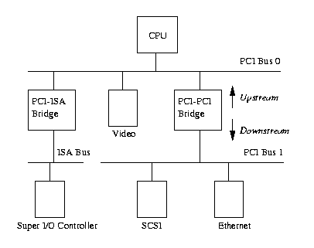
PCI & PCI Express
PCI based system build in a tree topology
PCI bus
Parallel connect devices and bridges
PCI-PCI Bridge
Connect two PCI buses
Become the root of lower bus
PCI-ISA Bridge
Connect to conventional ISA device

Slide 58
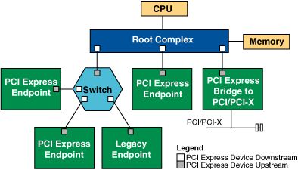
PCI & PCI Express
PCIe based system build in a point to point architecture
Root Complex
Similar to a host bridge in a PCI system, the root complex generates transaction requests on behalf of the processor, which is interconnected through a local bus.
Switch
Connect endpoint devices or other switches
Endpoint Device
Physical PCIe devices
Legacy PCI devices
PCI Express Bridge
Connect to other legacy subsystems

Slide 59
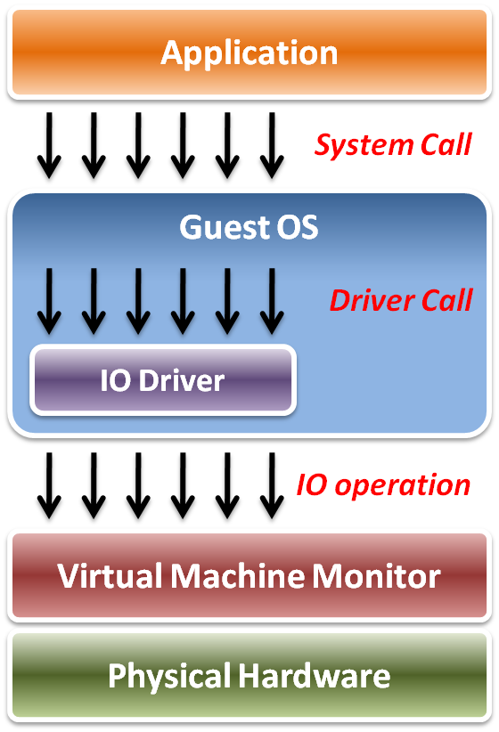
IO Virtualization
Implementation Layers:
System call
The interface between applications and guest OS.
Driver call
The interface between guest OS and IO device drivers.
IO operation
The interface between IO device driver of guest OS and virtualized hardware (in VMM).

Slide 60
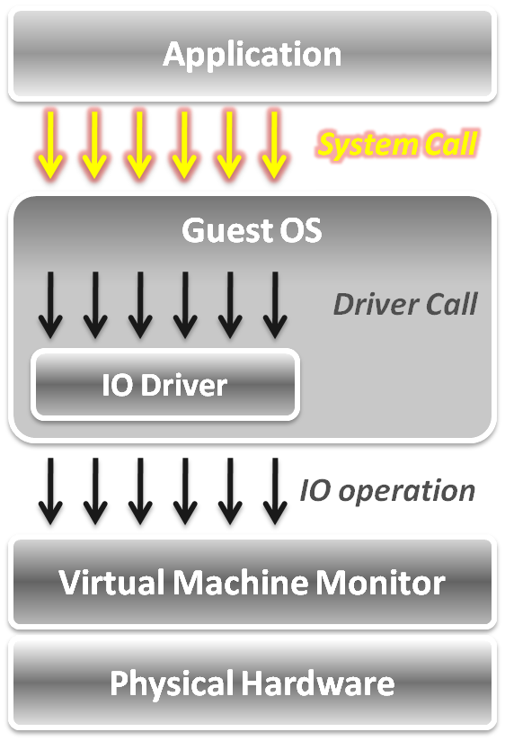
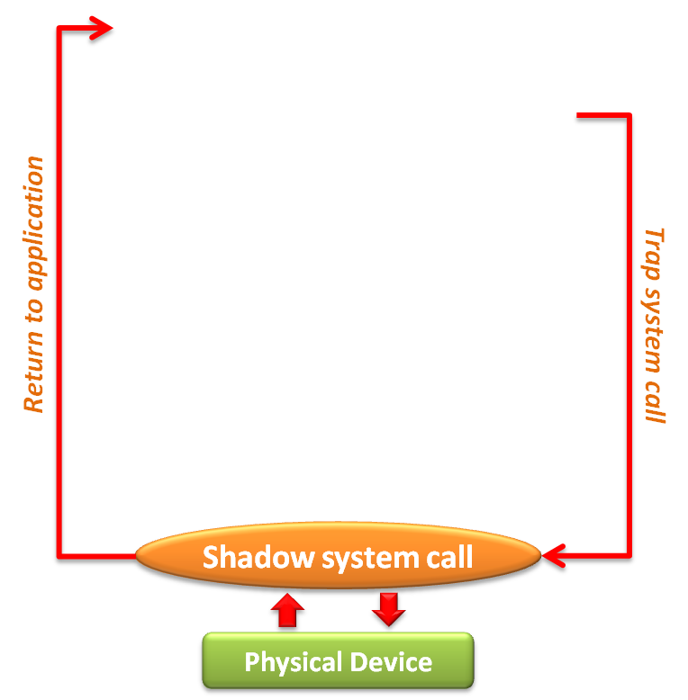
IO Virtualization
In system call level :
When an application invokes a system call, the system call will be trapped to VMM first.
VMM intercepts system calls, and maintains shadowed IO system call routines to simulate functionalities.
After simulation, the control goes back to the application in gust OS.

Slide 61
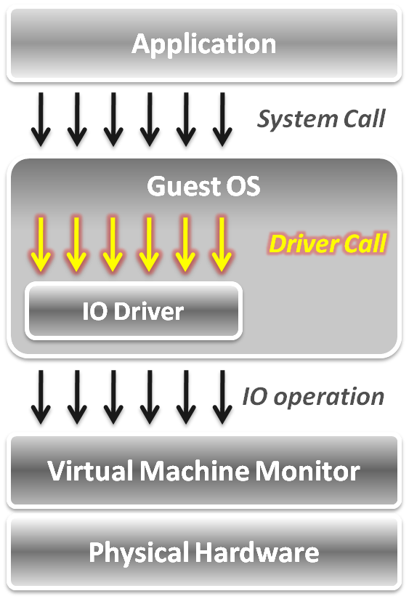
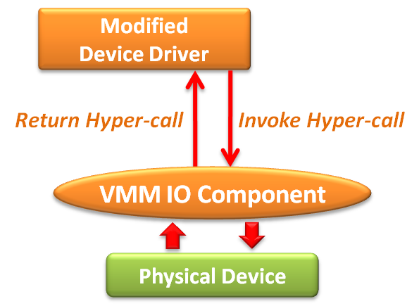
IO Virtualization
In device driver call level:
Adopt the para-virtualization technique, which means the IO device driver in guest OS should be modified.
The IO operation is invoked by means of hyper-call between the modified device driver and VMM IO component.

Slide 62
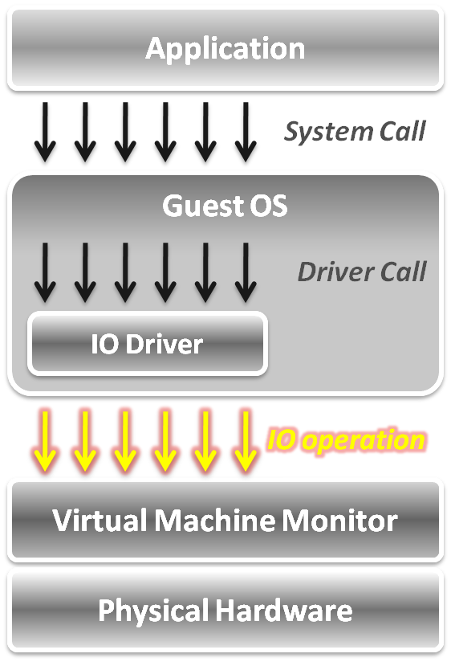
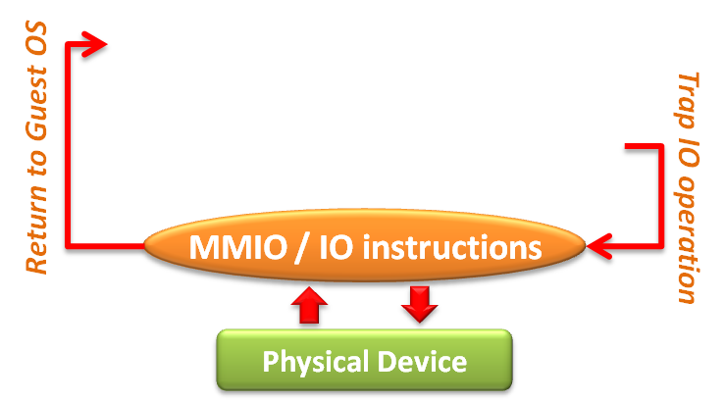
IO Virtualization
In IO operation level, two approaches :
Memory mapped IO
Loads/stores to specific region of real memory are interpreted as command to devices.
The memory mapped IO region is protected.
Port mapped IO
Special input/output instructions with special addresses.
The IO instructions are privileged .
Due to the privileged nature, these IO operations will be trapped to the VMM.

Slide 63
IO Virtualization
Overview
Device Model
Hardware Assistance

Slide 64
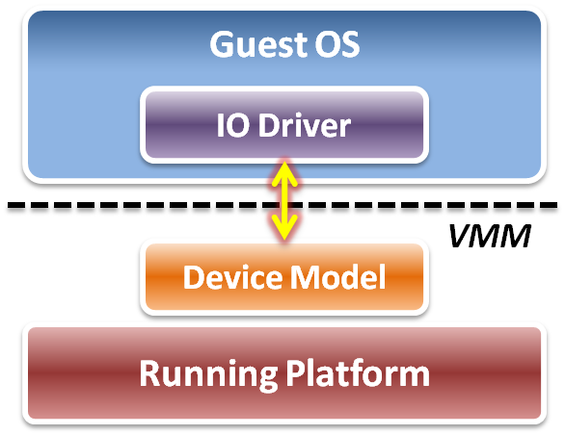
Device Model
Focus on IO operation level implementation.
This is an approach of full virtualization.
Logic relation between guest OS and VMM :
VMM intercepts IO operations from guest OS.
Pass these operations to device model on a running platform.
Device model needs to emulate the IO operation interfaces.
Port mapped IO
Memory mapped IO
DMA
... etc.

Slide 65
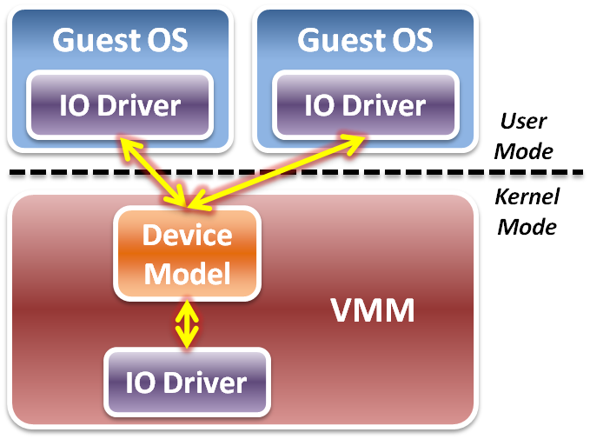
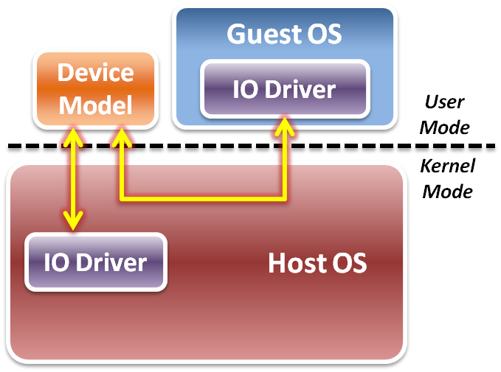
Device Model
Two different implementations of device model :
Device model is implemented as part of VMM.
Device model is running in user space as a stand alone service.
Type 1 Virtualization
Type 2 Virtualization

Slide 66
Device Model
IO virtualization flow
Initialization – device discovery
VMM will make guest OS discover the virtualized IO devices.
Then guest OS will load the corresponding device driver.
Operation – access interception
When guest OS executes IO operations, VMM will intercept those accesses.
After virtual device operations, VMM returns the control to guest OS.
Virtualization – device virtualization
Device model should emulate the real electronic logic to satisfy all device interface definition and its effects.
VMM may share physical devices to all virtual machines.

Slide 67
Device Discovery
Virtualize physical bus devices
Non-enumerable physical device
These devices have their own hard-coded numbers.
VMM should setup some status information on the virtual device ports.
For example, PS/2 keyboard and mouse.
Enumerable physical device
These devices defined a complete device discover method.
VMM have to emulate not only the device itself, but the bus behavior.
For example, PCI or PCI express devices.
Virtualize non-exist devices
VMM must define and emulate all functions of these devices
VMM may define them as either non-enumerable or enumerable devices.
Guest OS needs to load some new drivers of these virtual devices.

Slide 68
Access Interception
After virtual device discovered by guest OS, VMM has to intercept and control all the IO operations from guest OS.
Port mapped IO operation
Direct device assignment
VMM should turn ON the physical IO bitmap.
All the IO instructions (IN/OUT) from guest OS will be directly performed onto hardware without VMM intervention.
Indirect device assignment
VMM should turn OFF the physical IO bitmap.
All the IO instructions from guest OS will be intercepted by VMM and forward to physical hardware.

Slide 69
Access Interception
Memory mapped IO operation
Direct device assignment
VMM should use the shadow page table to map IO device addressing space of guest OS to the space of host.
Then all the IO operations from guest OS will not be intercepted.
Indirect device assignment
VMM should make the all entries of the IO device addressing space in the shadow page table to be invalid.
When guest OS access those addressing space, it will introduce the page fault which trap CPU to VMM for device emulation.
DMA mechanism
Address remapping
Because the device driver in the guest OS does not know the host physical address, VMM needs to remap the DMA target automatically when intercepting guest OS.

Slide 70
Device Virtualization
IO device types :
Dedicated device
Ex : displayer, mouse, keyboard …etc.
Partitioned device
Ex : disk, tape …etc
Shared device
Ex : network card, graphic card …etc.
Nonexistent physical device
Ex : virtual device …etc.

Slide 71
Device Virtualization
Dedicated device
Do not necessarily have to be virtualized.
In theory, requests of such device could bypass the VMM.
However, they are handled by the VMM first since OS is running in user mode.
Partitioned device
Be partitioned into several smaller virtual devices as dedicated to VM.
VMM translates address spaces to those of the physical devices.

Slide 72
Device Virtualization
Shared device
Should be shared among VMs.
Each VM has its own virtual device state.
VMM translates requests from a VM to physical device .
Nonexistent physical device
Virtual device “attached” to a VM for which there is no corresponding physical device.
VMM intercepts requests from a VM, buffers it and interrupts other VMs.

Slide 73
Performance Issues
When considering performance, two major problems :
How to make guest OS directly access IO addresses ?
Other than software approaches discussed above, we can make use of the hardware assistance (Intel EPT technique in memory virtualization) to map IO addresses from host to guest directly without software overhead.
How to make DMA directly access memory space in guest OS ?
For the synchronous DMA operation, guest OS will be able to assign the correct host physical memory address by EPT technique.
For the asynchronous DMA operation, hardware must access memory from host OS which will introduce the VMM intervention.

Slide 74
IO Virtualization
Overview
Device Model
Hardware Assistance

Slide 75
Hardware Solution
Difficulty :
Software cannot make data access directly from devices.
Two hardware solutions :
Implement DMA remapping in hardware
Remap DMA operations automatically by hardware.
For example, Intel VT-d .
Specify IO virtualization standards of PCI Express devices
Implement virtualizable device with PCI Express interface.
For example, SR-IOV or MR-IOV.

Slide 76
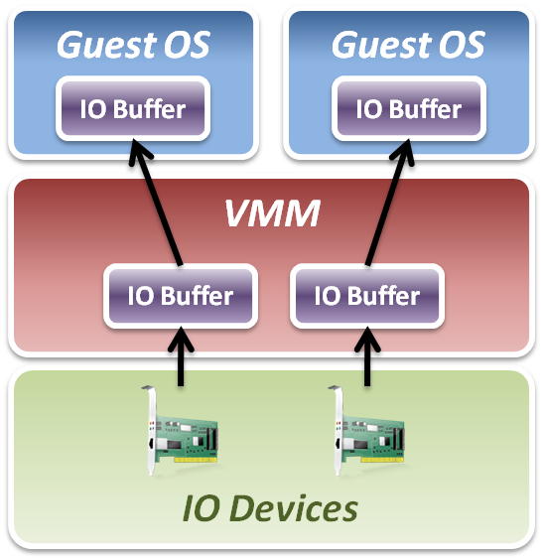
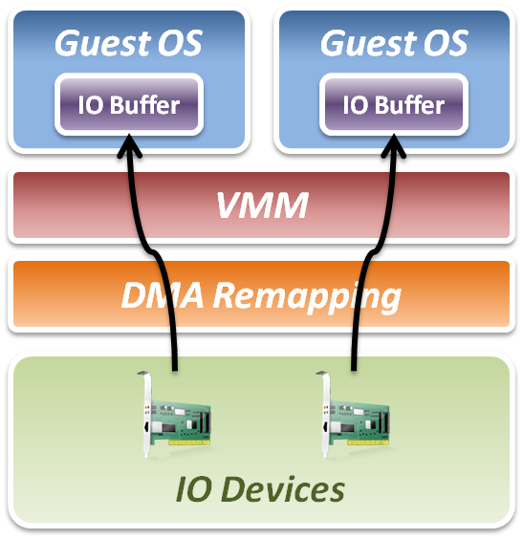
Intel VT-d
Add DMA remapping hardware component.
Software Approach
Hardware Approach

Slide 77
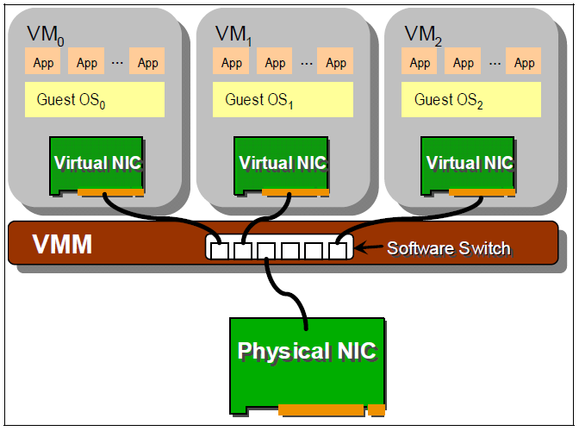
IO Virtualization Progress
Software based sharing
Implement virtualization by VMM software stack.
Advantage
Full virtualization without special hardware support.
Disadvantage
Significant CPU overhead may be required by the VMM.

Slide 78
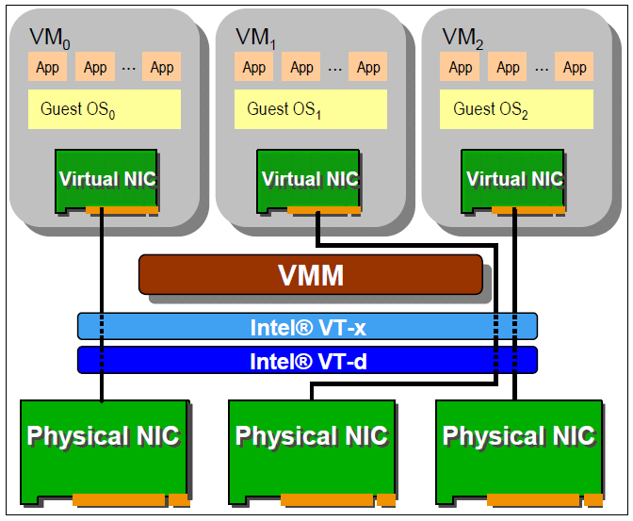
IO Virtualization Progress
Hardware direct assignment
Implement virtualization with Intel VT-x and VT-d supports.
Advantage
Data access bypass VMM.
Improve IO performance.
Disadvantage
Dedicate physical device assignment limit the system scalability.

Slide 79
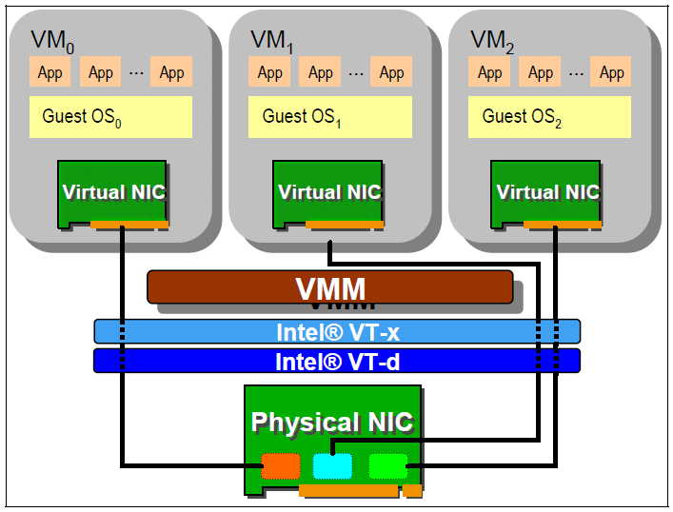
IO Virtualization Progress
New industrial standard
Instead of implementing virtualization in CPU or memory only, industry came up with new IO virtualization standard in PCI Express devices.
Advantages
Fully collaboration with physical hardware devices.
Improve system scalability.
Improve system agility.
Disadvantages
IO devices must implement with new specification.

Slide 80
Single Root – IO Virtualization
What is SR-IOV ?
The PCI-SIG Single Root I/O Virtualization and Sharing (SR-IOV) specification defines a standardized mechanism to create natively shared devices.
Basic components :
Physical Functions (PFs):
These are full PCIe functions that include the SR-IOV Extended Capability.
The capability is used to configure and manage the SR-IOV functionality.
Virtual Functions (VFs):
These are “lightweight” PCIe functions that contain the resources necessary for data movement but have a carefully minimized set of configuration resources.

Slide 81
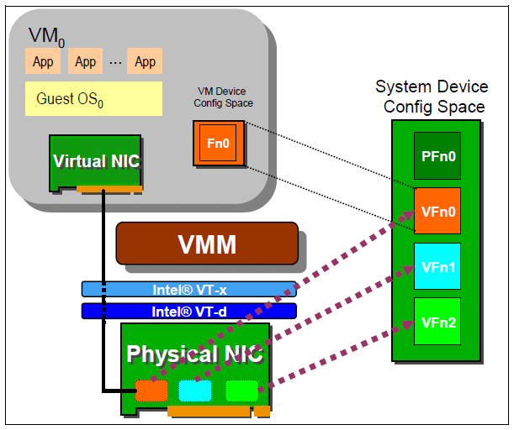
Single Root – IO Virtualization
SR-IOV works with VMM :
VMM
An SR-IOV-capable device can be configured to appear in the PCI configuration space as multiple functions.
VM
The VMM assigns one or more VFs to a VM by mapping the actual configuration space the VFs to the configuration space presented to the virtual machine by the VMM.

Slide 82
IO Virtualization Summary
IO subsystem architecture
Port Mapped IO vs. Memory Mapped IO
Direct Memory Access (DMA)
PCI / PCI Express
IO virtualization
Three implementation layers
IO virtualization paradigm with device model
Hardware assistance
DMA remapping hardware
Single Root – IO Virtualization specification

Slide 83
Server Virtualization Ecosystem
VMware Xen KVM Hyper-V

Slide 84
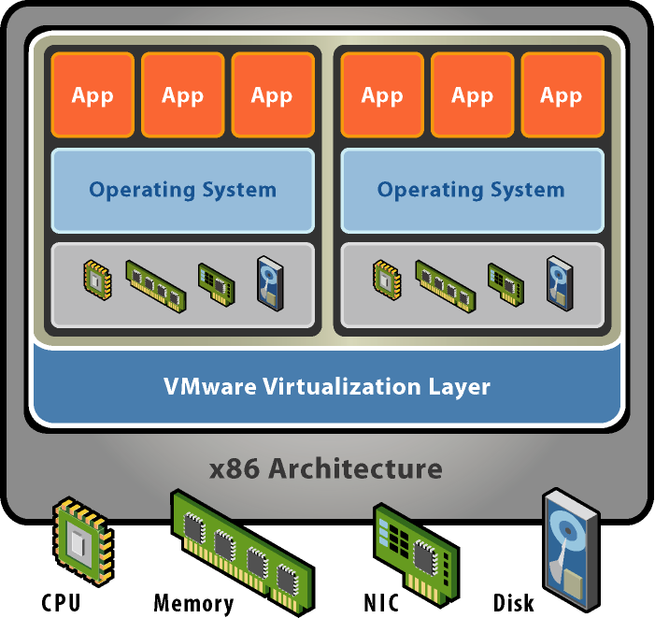
VMware
Basic properties :
Separate OS and hardware – break hardware dependencies
OS and Application as single unit by encapsulation
Strong fault and security isolation
Standard, HW independent environments can be provisioned anywhere
Flexibility to chose the right OS for the right application

Slide 85
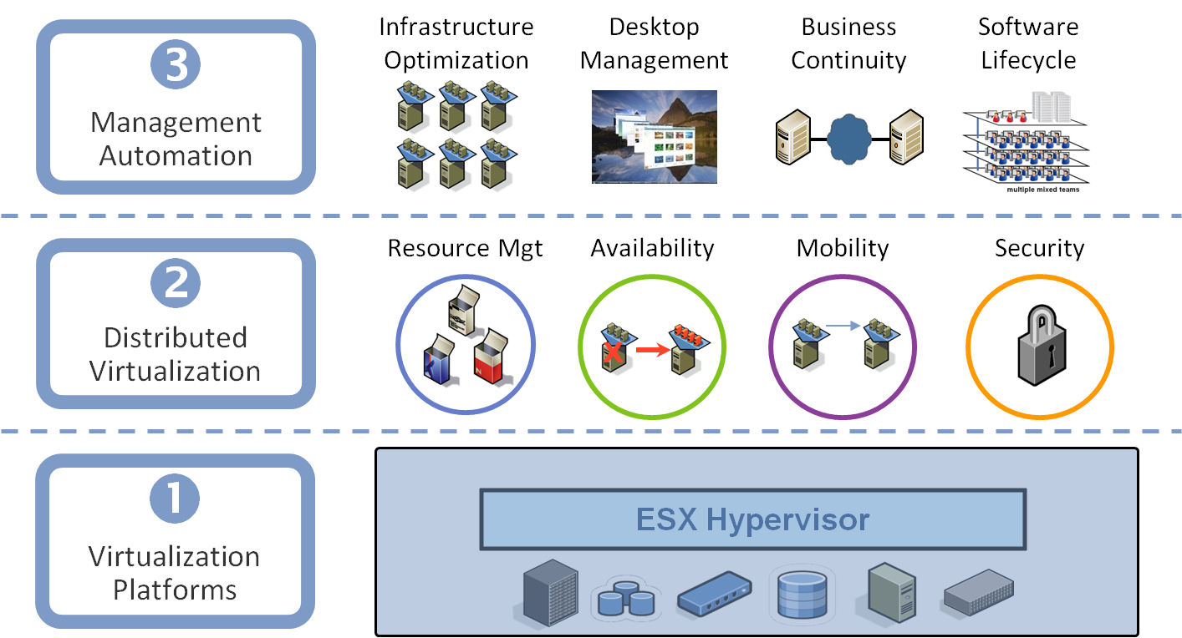
VMware Virtualization Stack

Slide 86
VMware Major Products
VMware GSX Server
Run multiple servers on your server
Hosted Architecture
Available for Linux hosts and Windows hosts
VMware ESX Server
Quality of Service
High-performance I/O
Host-less Architecture ( bare-metal )

Slide 87
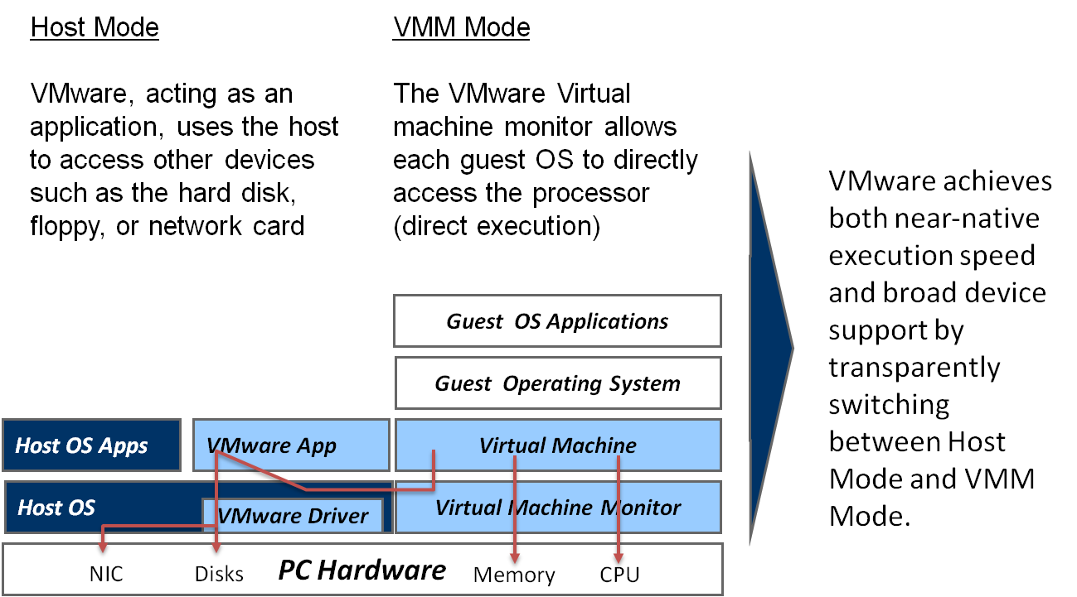
VMware GSX Server Architecture

Slide 88
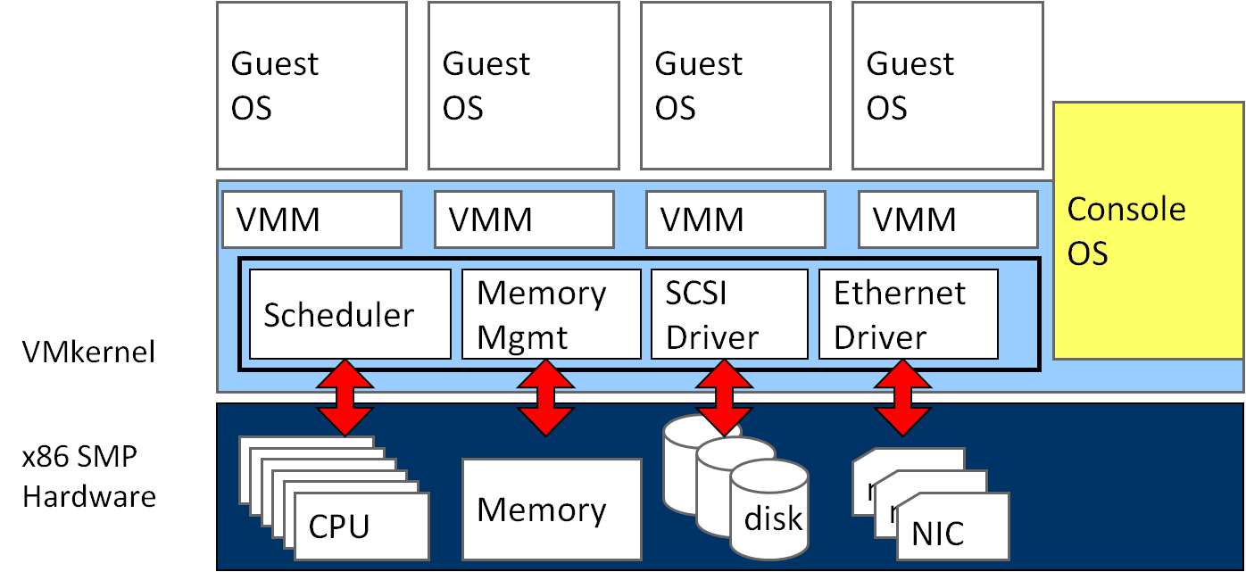
VMware ESX Server Architecture

Slide 89
Xen
Basic properties :
Para-virtualization
Achieve high performance even on its host architecture (x86) which has a reputation for non-cooperation with traditional virtualization techniques.
Hardware assisted virtualization
Both Intel and AMD have contributed modifications to Xen to support their respective Intel VT-x and AMD-V architecture extensions.
Live migration
The LAN iteratively copies the memory of the virtual machine to the destination without stopping its execution.
Implement system:
Novell's SUSE Linux Enterprise 10
Red Hat's RHEL 5
Sun Microsystems' Solaris

Slide 90
Para-virtualization in Xen
Xen extensions to x86 arch
Like x86, but Xen invoked for privileged instructions
Avoids binary rewriting
Minimize number of privilege transitions into Xen
Modifications relatively simple and self-contained
Modify kernel to understand virtualized environment
Wall-clock time vs. virtual processor time
Desire both types of alarm timer
Expose real resource availability
Enables OS to optimize its own behaviour

Slide 91
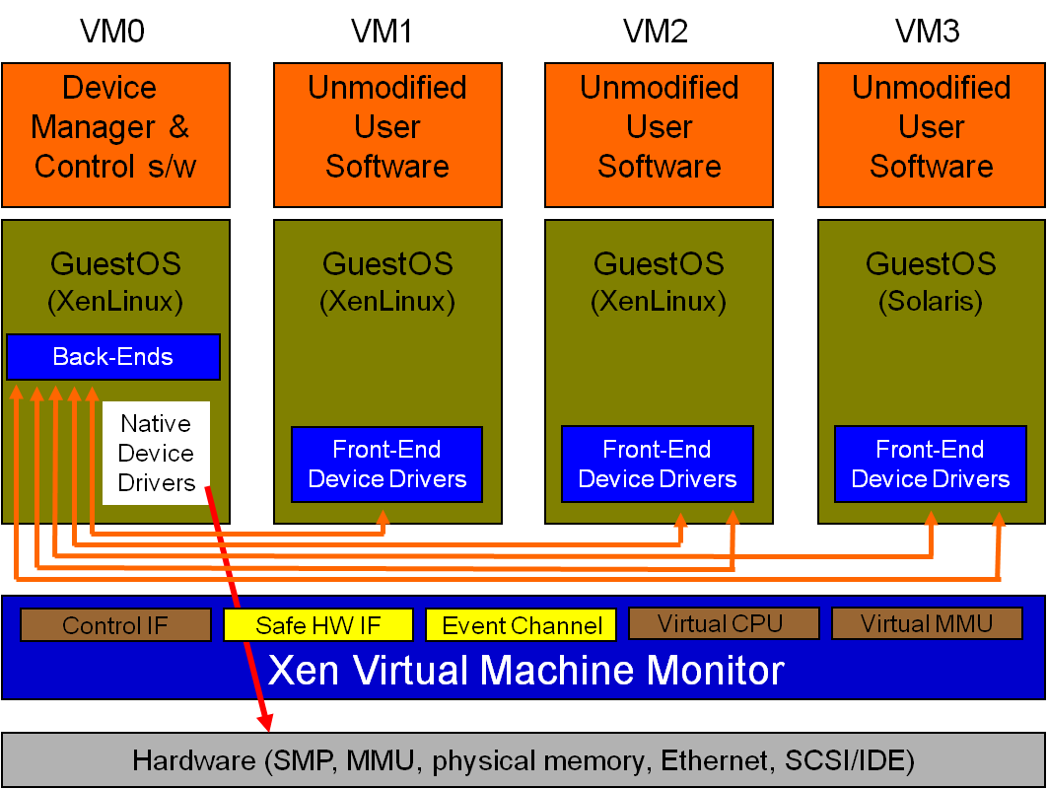
Original Xen Architecture

Slide 92
Hardware Assistance in Xen
Hardware assistance:
CPU provides VMExit for certain privileged instructions
Extend page tables used to virtualize memory
Xen features:
Enable Guest OS to be run without modification
For example, legacy Linux and Windows
Provide simple platform emulation
BIOS, apic, iopaic, rtc, Net (pcnet32), IDE emulation
Install para-virtualized drivers after booting for high-performance IO
Possibility for CPU and memory para-virtualization
Non-invasive hypervisor hints from OS

Slide 93

New Xen Architecture

Slide 94
KVM
KVM ( Kernel-based Virtual Machine)
Linux host OS
The kernel component of KVM is included in mainline Linux, as of 2.6.20.
Full-virtualization
KVM is a full virtualization solution for Linux on x86 hardware containing virtualization extensions (Intel VT or AMD-V).
Using KVM, one can run multiple virtual machines running unmodified Linux or Windows images.
IO device model in KVM :
KVM requires a modified QEMU for IO virtualization framework.
Improve IO performance by virtio para-virtualization framework.

Slide 95

KVM Full Virtualization
It consists of a loadable kernel module
kvm.ko
provides the core virtualization infrastructure
kvm-intel.ko / kvm-amd.ko
processor specific modules

Slide 96

IO Device Model in KVM
Original approach with full-virtualization
Guest hardware accesses are intercepted by KVM
QEMU emulates hardware behavior of common devices
RTL 8139
PIIX4 IDE
Cirrus Logic VGA

Slide 97

IO Device Model in KVM
New approach with para-virtualization

Slide 98

IO Device Model in KVM
virtio architecture

Slide 99
Other Issues
Live migration
Cloud properties

Slide 100
Other Issues
Essential technique of cloud properties implementation
Live migration of virtual machines
Migrate a virtual machine from one physical machine to another in the run time with a small amount of performance down grade.
Virtualization enabled cloud properties :
Scalability
Virtual machine system automatic scale up
Availability
Fault tolerant of hardware and software
Manageability
Automatic physical to virtual system transformation
Performance
Dynamically virtual machine level load balancing

Slide 101

Live Migration Technique
Pre-assumption :
We assume that all storage resources are separated from computing resources.
Storage devices of VMs are attached from network :
NAS: NFS, CIFS
SAN: Fibre Channel
iSCSI, network block device
drdb network RAID
Require high quality network connection
Common L2 network (LAN)
L3 re-routing
VM 1
VM 2
VM 2
Disk
VM 1
Disk

Slide 102

Live Migration Technique
Challenges of live migration :
VMs have lots of state in memory
Some VMs have soft real-time requirements :
For examples, web servers, databases and game servers, ...etc.
Need to minimize down-time
Relocation strategy :
Pre-migration process
Reservation process
Iterative pre-copy
Stop and copy
Commitment

Slide 103

Live Migration Technique
Pre-migration process
Reservation process
VM active on host A
Destination host selected (Block devices mirrored)
Initialize container on target host
Copy dirty pages in successive rounds
Suspend VM on host A
Redirect network traffic
Synch remaining state
Activate on host B
VM state on host A released
Iterative pre-copy
Stop and copy
Commitment

Slide 104
Live Migration Technique
Pre-copy migration : Round 1
Host A
Host B

Slide 105
Live Migration Technique
Pre-copy migration : Round 2
Host A
Host B

Slide 106
Live Migration Technique
Stop and copy : Final Round
Host A
Host B

Slide 107




Scalability in Virtualization
Scalability implement by VMware:
VMware VMotion, makes it possible to move Virtual Machines, without interrupting the applications running inside.
Dynamically scale up virtual machine system among physical servers.

Slide 108
Availability in Virtualization
Fault tolerance system:
VMware makes all Servers and Applications protected against component and complete system failure.
When system failure occurs, virtual machines will be automatic restarted on other physical servers.
X

Slide 109
Availability in Virtualization
Disaster recovery:
VMware Site Recovery Manager enables an easy transition from a production site to a Disaster Recovery site.
Easy Execution for real Disaster
Easy Testing for good night sleep
X

Slide 110


Availability in Virtualization
Fail over technique
Backup VM
Backup VM
X
Application protection against hardware failures, with NO down time that is Application and Operating System Independent.

Slide 111
Manageability in Virtualization
Provide physical to virtual translation:
Consolidation Management with the VMware Infrastructure software will automate the migration from physical to virtual machines.

Slide 112
Performance in Virtualization
Dynamic load balancing:
VMware Distributed Resource Scheduler automatically balances the Workloads according to set limits and guarantees.
Removing the need to predict resource assignment.

Slide 113

Performance in Virtualization
Optimize network access:
VMware and Cisco are collaborating to enhance workload mobility and simpler management with virtualization-aware networks.
Nexus 1000V

Slide 114







Security in Virtualization
Enhance virtual machine security protection:
The Application vService VMSafe allows security vendors to add superior security solutions inside the VMware Infrastructure.

Slide 115

Summary
Server virtualization technique:
CPU virtualization
Ring compression, Intel VT-x, …etc
Memory virtualization
Shadow page table, Intel EPT, …etc
IO virtualization
Device model, Intel VT-d, PCIe SR-IOV, …etc
Ecosystem :
VMware implements both type-1 & type-2 virtualization
Xen implements both para and full virtualization
KVM implements in Linux mainstream kernel
Hyper-V
Cloud properties :
Enabled by live migration technique
Scalability, Availability, Manageability and Performance
Hyper-V

Slide 116
Pros and Cons of Server Virtualization
Pros
Cost
Less physical servers
Less server space (consolidation of servers)
Less energy costs
Less maintenance
Efficient Administration
Easier management, management through one machine
Single point of failure
Smaller IT staff

Slide 117
Pros and Cons of Server Virtualization
Pros
Growth and Scalability
Upgrading one server upgrades them all
Easy growth
Less hardware complications
Security
Single server security maintenance
Hypervisor software often provides security benefits
Legacy Servers
Upgrading servers to a virtual setup from old systems
Goes hand-in-hand with scalability

Slide 118
Pros and Cons of Server Virtualization
Cons
Slow Performance
High stress on single machine
Longer processing times
More network bottlenecking
Single Point of Failure
Many servers on one host machine
Hardware or software failures can be critical
Backup servers will need to be setup

Slide 119
Pros and Cons of Server Virtualization
Cons
Cost
High initial investment
Software licensing costs
Security
All servers through one machine
Learning curve
Many different types of software
Different architecture

Slide 120
Pros and Cons of Dedicated Servers
Pros
High Performance
All resources on server are dedicated
Can handle high stress scenarios
Multiple Points of Failure
Easier to identify problems
Only one server will fail at a time

Slide 121
Pros and Cons of Dedicated Servers
Pros
Price
Old servers already exist
No long term investments
If it’s not broke, don’t fix it
Small Learning Curve
Dedicated servers have been around for a long time
IT staff will not need to learn any new systems if dedicated servers already exist

Slide 122
Pros and Cons of Dedicated Servers
Cons
Price
Long term costs of dedicated servers can add up
More applications and services = more servers
Servers not being utilized
Servers may not be efficient
Even at peak, some servers may not need all resources

Slide 123
Pros and Cons of Dedicated Servers
Cons
Lack of growth and consistency
Adding servers for more services and applications
Expanding of physical space with servers
Software patches and updates will be inconsistent
Management can be difficult and inconsistent

